Slide 1
Freelancer Project Management System (FPMS)
By Gerardo Rivera and Jesse

Slide 2
The Problem
Bookkeeping multiple contracts can be time consuming
Tracking hours, expenses, details on each project
Keeping clients updated and informed is time consuming
Client communication can be lost through spam emails or texts.
The Solution
A single platform to handle all aspects of freelancing/contract work
Easy client to contractor communication
Easy bookkeeping and sharing
Collaboration features

Slide 3
Class Entities
User
Project
Task
Client
User_id
Name
Email
Password
Role
Project_id
Title
Description
Client_id
Task_id
Project_id
Assigned_to
Description
Deadline
Status
Client_id
Name
Email
Password
Project_id
Payment
Message
Review
Payment_id
Project_id
Amount
Date
Status
Message_id
Sender_id
Review_id
Content
Timestamp
Review_id
Project_id
Rating
Comment
Date

Slide 4
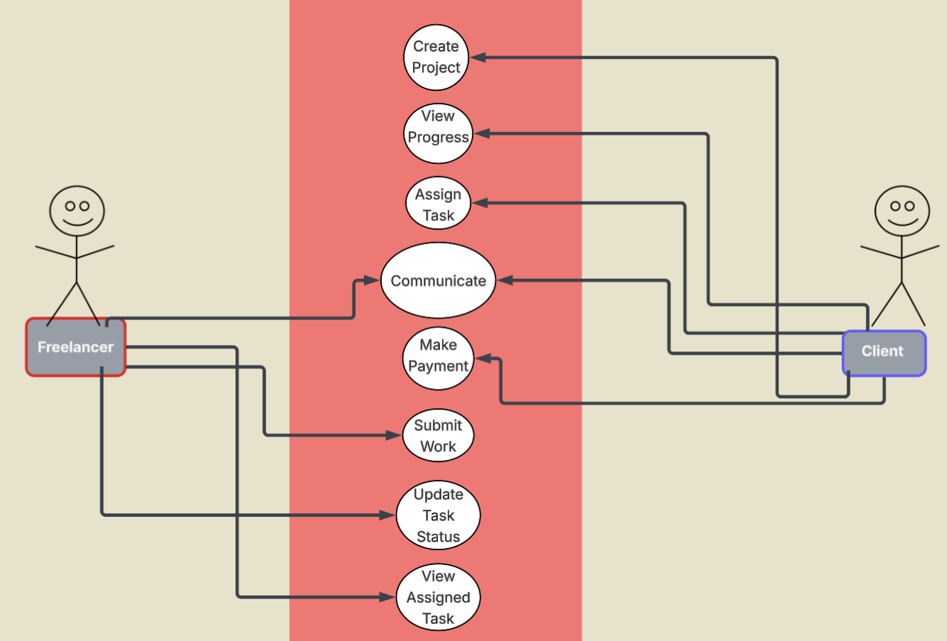
Use Cases

Slide 5
Use Cases cont.
Freelancer uses platform to communicate updates on contract work while the client can easily view updates on what they requested to be done.
Freelancer can submit updates on task statuses and viewing tasks, while also communicating with client on the platform.
Client can view updates on tasks and assign them to people working on the same project, and view progress.

Slide 6
E/R Diagram
Email
user_id
Name
Title
Description
project_id
Date
amount
User
Password
project_id
Client_id
payment_id
Status
Role
Project
Payment
Name
Client
Client_id
Project_id
Email
Password
Task
Description
Review
Status
Message
Rating
Comment
Deadline
Message_id
Timestamp
Task_id
Project_id
Review_id
Date
Project_id
Sender_id
Content
Reciver_id

Slide 7
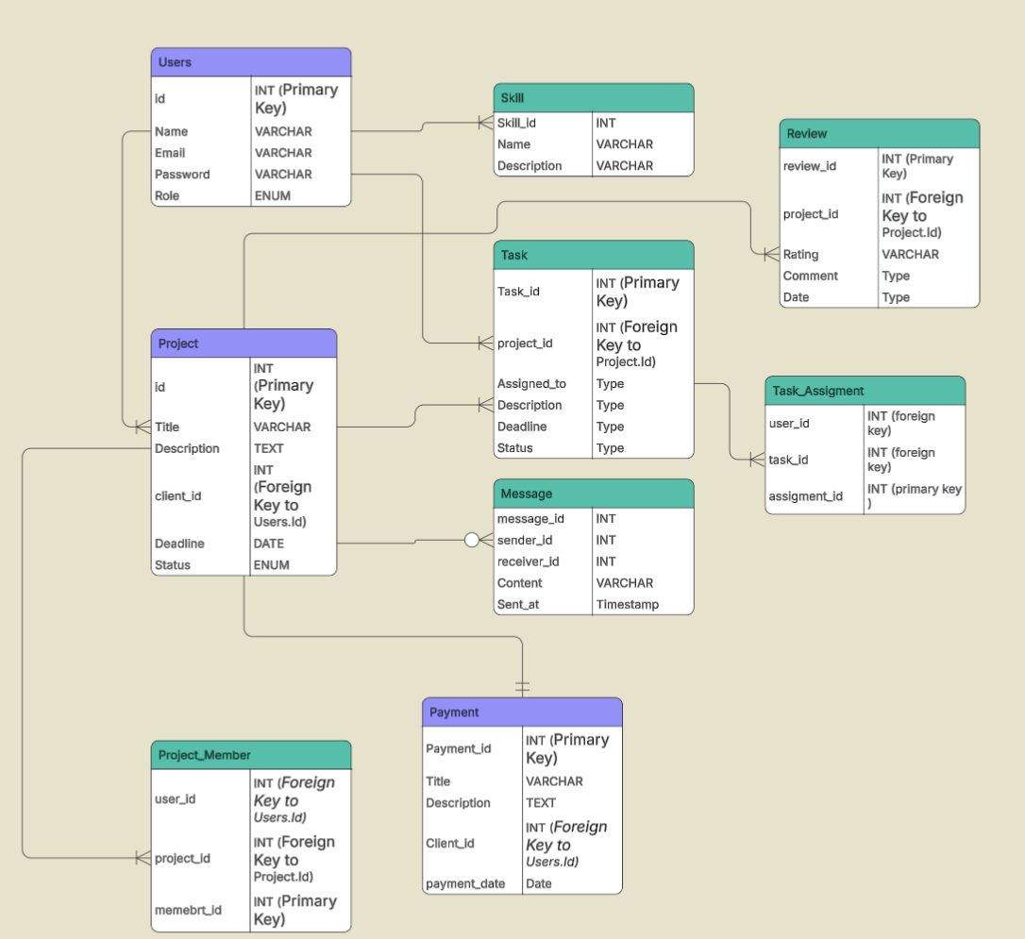
Relational Schema

Slide 8
Thank you

